Slide 1
Closing a Project

Slide 2
Closing a Project
PRINCE2® manual page 205
Workbook page 277

Slide 3
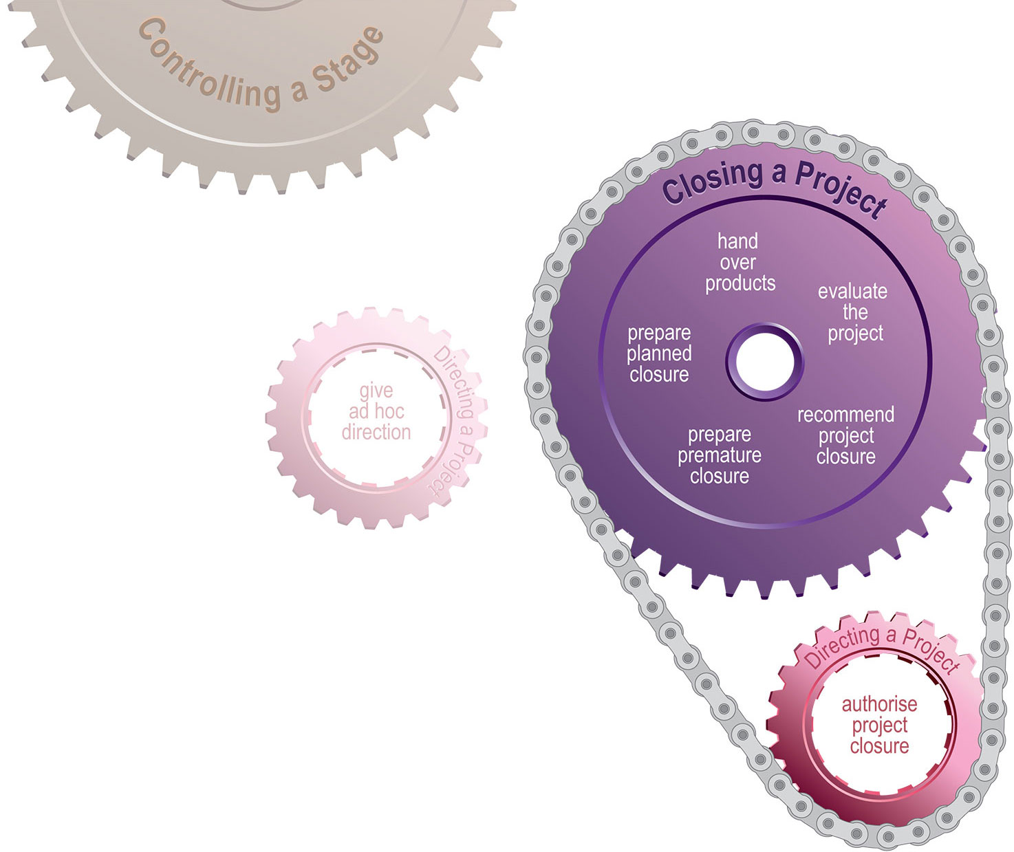
Closing a Project
Process

Slide 4
Closing a Project
Introduction
Benefits are reviewed
Unrealised benefits are planned for
Major deliverables are
  End Project Report
  Lessons Report
  Updated Benefits Review Plan
Objectives have been achieved or nothing more to contribute

Slide 5
Closing a Project
Objectives
Hand over products for acceptance and support
Evaluate the project to:
  review performance
  assess any realised benefits
Manage the end of a project: planned or premature

Slide 6
Closing a Project
Activities
Prepared planned closure
  Update the project plan with actual time and costs
  Confirm the Project Product Description has been delivered and Acceptance Criteria have been met
  Seek approval that resources can be released.
Prepare premature closure
  Work should not be abandoned, but salvages value
  Record closure request in Project Plan and Issue Register
  Use a Product Status Account to determine status of products.

Slide 7
Closing a Project
Activities
Hand over products
  Operation & maintenance responsibility is assigned
  Benefits derived from products may need to be scheduled
  Follow-on actions include outstanding risks and issues.
Evaluate the project
  End Project Report and Lessons Report are created
  Assess how successful the project has been.
Recommend project closure
  Notifications to those as required, logs & registers closed

Slide 8
Closing a Project
Principles
Continued business justification
Learn from experience
Defined roles and responsibilities
Manage by stages
Manage by exception
Focus on products
Tailor to suit project environment

